Slide 1
Welcome to SDZ’s Python Workshop #4
By Riko Hamblin and Ibukun Oluwayomi

Slide 2
Agenda for Today
Functions
Using Files
App of the day

Slide 3
Functions
Functions are reusable code blocks. They provide a way to write code only once then use it multiple times in various locations.
By keeping all the code associated with a particular step in one place it makes code maintainable and readable.

Slide 4
Basic Idea of a function
Function
Inputs
Outputs

Slide 5
Basic Idea of a function
Function
Inputs
Outputs
The number of inputs could be 0,1 or more
The number of outputs could be 0,1 or more.

Slide 6
You have been using Functions all along!
Think of:
raw_input(“Enter a name: “)
var = ‘lower’.upper( )
square = math.pow(3, 2)
……..We can name functions all day!
square = 9

Slide 7
Let’s make one….
def firstfunction ( num1 , num2 ): result = num1 / num2 return result

Slide 8
Let’s make one….
Parameters
def firstfunction ( num1 , num2 ): result = num1 / num2 return result
#How do we use a function?

Slide 9
Let’s make one….
Parameters
def firstfunction ( num1 , num2 ): result = num1 / num2 return result
#How do we use a function? ans = firstfunction(3,5) print ans print firstfunction(10,5)
Notice what is indented and what is not

Slide 10
You can also specify the exact parameters...
print firstfunction(num2 = 3, num1 = 5)

Slide 11
Arguments vs Parameters
Arguments are given to a function when it’s being called
Parameters are defined in the function definition

Slide 12
Let’s make one….
Parameters
def firstfunction ( num1 , num2 ): result = num1 / num2 return result
#How do we use a function? ans = firstfunction(3,5) print ans print firstfunction(10,5)
Notice what is indented and what is not
Arguments

Slide 13
Default arguments
# Function definition is here def printinfo( name, age = 35 ): print "Name: ", name print "Age ", age # Now you can call printinfo function printinfo( age=50, name="miki" ) printinfo( "miki" )

Slide 14
How to define a function
Let’s See …..
def name_of_function(arguments):
Do stuff with arguments
return result

Slide 15
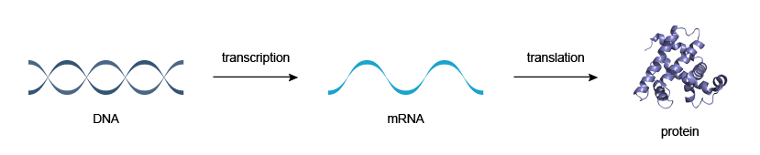
App of the day.
DNA SEQUENCE TO PROTEIN CONVERTER
NUCLEOTIDE TRIPLETS TO AMINO ACID

Slide 16
Quick background on Genetics
The Central Dogma of Molecular Biology: DNA makes RNA, RNA makes proteins.
Transcription is the process by which DNA is copied (transcribed) to RNA, which carries the information needed for protein synthesis.
Translation is the process by which RNA gets converted into a protein. (sequence of amino-acids)

Slide 17
Video
Genetics video

Slide 18
Example
T = Thymine.(only in DNA)
A = Adenine.
C = Cytosine
G = Guanine
U = Uracil (only in RNA)
This is our DNA strand.
TCGTCGACGATGATCATCGGCTACTCGA

Slide 19
Step 1 . Convert to RNA
T = Thymine.(only in DNA)
A = Adenine.
C = Cytosine
G = Guanine
U = Uracil (only in RNA)
This is our DNA strand.
TCGTCGACGATGATCATCGGCTACTCGA
Equivalent RNA
UCGUCGACGAUGAUCAUCGGCUACUCGA
Notice that all the ‘T’ s were converted to ‘U’s

Slide 20
Step 2 . Convert codons to amino acid
A codon is a group of three nucleic acids. Triplets.
E.g AUGGCAUAUAAA
Each color is a codon. Each codon represent an amino acid.
AUG => Methionine. (M) GCA => Alanine. (A) UAU => Tyrosine. (Y) AAA => Lysine. (K)
There is a table that makes the mapping easy.

Slide 21
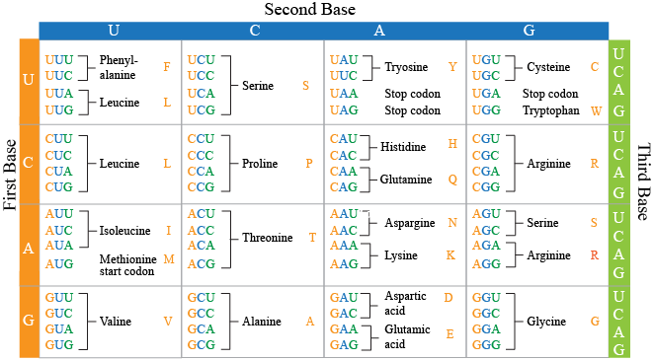

Slide 22
What Data structure does the table remind you of?
Program specification.
We are given a file containing a DNA sequence. Our task is to convert the DNA sequence to an amino acid sequence (protein) and store the result in another file.
Input file = ATGGCATATAAA
Output file = MAYK
Why?
If DNA = ATGGCATATAAA
Then RNA = AUGGCAUAUAAA
Then amino acid is AUG => Methionine. (M) GCA => Alanine. (A) UAU => Tyrosine. (Y) AAA => Lysine. (K)
Which is MAYK

Slide 23
Thought Process
Read DNA sequence from file and store in a variable.
We need to store it as a string
Convert DNA sequence into RNA sequence. Change T-U
We need a function that will return the RNA sequence when we pass it a DNA sequence.
Convert RNA sequence into amino acid sequence. (Groups of 3)
We need a data structure that maps the triplets to the corresponding amino-acid
We need a function that will return a protein sequence when we pass it a RNA.
Write amino acid sequence in the output file.
Create and output file and write to it

Slide 24
Files
Instead of getting information from a user ( raw_input( ) ) or “hard-coding” in into our code we can get it from it a file.
After opening a file we can:
Read from a file
Write to a file

Slide 25
Reading from a file
f = open(“input.txt”, “r”)
for line in f: print line
f.close( )

Slide 26
Opening a file
file_variable = open(“filename”, “mode”)
The modes are:
‘r’ – Read mode which is used when the file is only being read
w’ – Write mode which is used to edit and write new information to the file (any existing files with the same name will be erased when this mode is activated)
‘a’ – Appending mode, which is used to add new data to the end of the file; that is new information is automatically amended to the end
‘r+’ – Special read and write mode, which is used to handle both actions when working with a file

Slide 27
Reading from a file
f = open(“input.txt”, “r”)
all_content = f.read( )
print all_content

Slide 28
Writing to the file
f = open(“input.txt”, “r”) output = open(“output.txt”, “w”)
for line in f: print line output.write(line)
f.close( ) output.close( )

Slide 29
Writing to the file - using “a”
f = open(“input.txt”, “r”) output = open(“output.txt”, “a”)
for line in f: print f output.write(line)
f.close( ) output.close( )

Slide 30
Small task using files…
Let’s go to Pycharm …...

Slide 31
Thought Process
Read DNA sequence from file and store in a variable.
We need to store it as a string
Convert DNA sequence into RNA sequence. Change T-U
We need a function that will return the RNA sequence when we pass it a DNA sequence.
Convert RNA sequence into amino acid sequence. (Groups of 3)
We need a data structure that maps the triplets to the corresponding amino-acid
We need a function that will return a protein sequence when we pass it a RNA.
Write amino acid sequence in the output file.
Create and output file and write to it

Slide 32
Let’s Write Some Code!

Slide 33
Congratulations
We finished our workshop!

